Slide 1
Early Childhood Education
John Oberst, Cecilia (Cora) Myers, and Teddy Hickenlooper
Notes:
Teddy

Slide 2
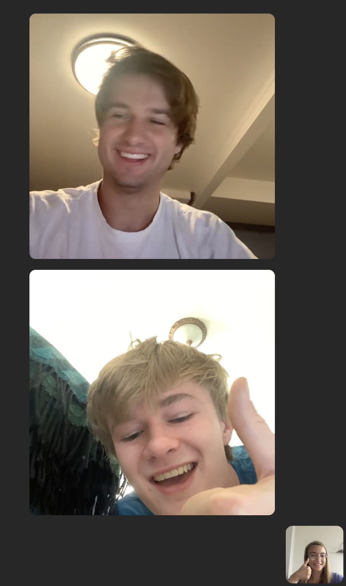
LISTEN. THINK. ACT.
Listen:
-Sharon Carnahan
-Noeline Kirabo
-GLI Cohort 1
Think:
Act:
-Survey
-Plan of action
Notes:
Teddy, John, Cecilia in that order

Slide 3
Survey
Parental Survey
Eleven question survey formulated with the purpose of data collection to benefit future action
The questions are designed to determine how involved parents are in the education of their child and what specific areas they can be more supportive in
Additional questions focus on what parents would like to see changed in order to better their child's education.
Student focused Survey
The student survey is designed to discover overlap and disconnect between the answers of the parents and the answers of their children.
A majority of the questions overlap with questions we asked the parents.
More malleable survey design then the parental survey
Notes:
John

Slide 4
Sample Questions
Parental Survey
Student Focused Survey
How important is it to you to be involved in helping with your child’s schoolwork?
Is there anything that your child is not receiving in school, that you believe they should be receiving?
Around how many times per week do you read with your child?
Around how many hours per day does your child spend on schoolwork?
How often do your parents help you with schoolwork?
Is there anything you wish you would learn in school?
Around how many times per week do you read with your parents?
Notes:
Cecilia

Slide 5
Plan of action
Work with Enjuba to find a solid sample size of parents in which to distribute and conduct the survey.
Form a focus group of parents, teachers and community leaders to create an action plan to step up parental involvement.
Determine the areas of focus for the outreach program based on survey data and individual responses
Link to our plan: https://docs.google.com/document/d/174e9GKsUtFIXPG7wDCA1i7aNEqKO_gtP287s_PxuWzM/edit?usp=sharing
Notes:
Teddy

Slide 6
Next Steps for following cohorts
Immediate Next Steps
Fundraising
Review and continue fundraiser of Cohort #1 (Spelling bee, online campaign, etc.)
Possible follow up surveys
Collect data from educators
Collect data on activities outside of schoolwork to try and find new ways to reach out to kids
Collect data on financial literacy
Developing a plan of parent outreach
Reach out to possible collaborators such as the Church of Uganda, Mothers Union
Future Goals
Increased Fundraising
Assess fundraising options for bigger budgeted investments (i.e. school bus, cafeteria, etc.)
Teacher Outreach
Working with the NICED Policy and Action Plan
Making resources more available to teachers
School Food Program
Children suffering from malnutrition or hunger at school tend to suffer academically as a result of the circumstances
Notes:
Immediate next steps: cecilia
Future goals: john

