Slide 1
COVID-19 Response: International Exchange in U.S. and Uganda
Group Members: Noble Ricky Naturinda, Nathan Charles, Arnold Zziwa, Veronica Navarrete, Valerie Nguyen

Slide 2
Research Objectives
Establish COVID-19 responses and impact on universities in U.S. and Uganda regarding international exchange
Impact of COVID-19 pandemic on schools - school closures, transition to online platforms, and further implications
Current hygiene recommendations practiced and implemented in Ugandan schools
Recommendations, specifically on hand-washing implementation and access, for COVID-19 response in Uganda and Ugandan schools
Suggestions on the development of a COVID-19 relief globally and within Uganda

Slide 3
COVID-19 in U.S.
Impacts on universities
Valerie Nguyen
New York University
Location: New York, New York
Population: 8.399 million
NYC is close to 470 sq. miles
COVID-19 status (NYC Health)
6,721 active as of 11/16/2020
19,460 total deaths
Implemented 3-tier COVID-19 response:
1. Universal arrival testing for everyone on campus or interacting with NYU community.
2. Mandatory ongoing testing for students, faculty, staff
3. Clinical testing for students who develop symptoms consistent with COVID-19 or individuals who may have been exposed to an infected person.

Slide 4
COVID-19 in U.S.
Impacts on universities
Valerie Nguyen
New York University
COVID-19 in NYU (NYU)
Total tests conducted: 12,557
Positive cases: 28 as of 11/7/2020
0.22% positive rate
Total positive cases: 439 since 8/1/2020
Currently operating both in-person and remote classes
Implications on international exchange/study abroad (NYU Go Local)
NYU offers “Go Local” option for Spring 2021
Students may enroll at other NYU locations to take classes without support of a student visa
NYU Abu Dhabi, NYU Shanghai
Continued suspension of NYU’s exchange programs for Spring 2021
Will resume exchange programs until it is appropriate to do so
Notes:
Abu Dhabi in United Arab Emirates.

Slide 5
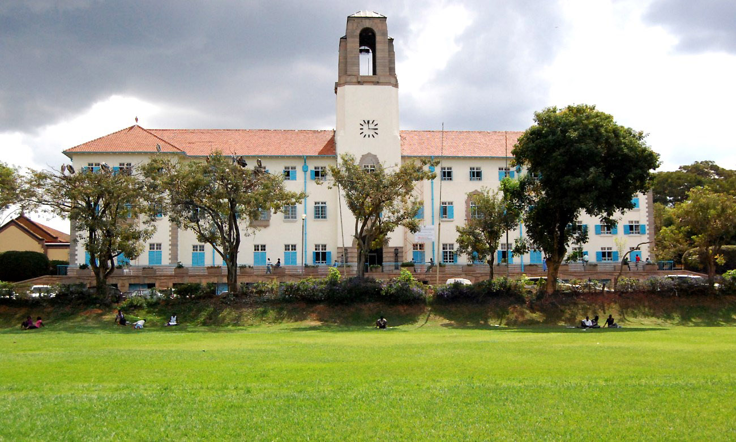
COVID-19 in Uganda
Impacts on universities
Valerie Nguyen
Makerere University (Makerere News)
University instituted committee on COVID-19 Preparedness which include
Implementing Ministry of Health guidance and recommendations on preventing COVID-19 at Makerere University
Identifying need for University requirement for more hand-washing and disinfection facilities.
Makerere University also created a Coronavirus Resource Center to help inform the public and brief policymakers.
Coronavirus Resource Center is more like a generalization of Uganda’s COVID-19 status without specifics into university demographics.
International Exchange
Likelihood of remaining unchanged within the foreseeable future.
Similar to what NYU suggested, opportunity to have study exchange in areas close to students’ homes if there is room to even consider.
Notes:
Abu Dhabi in United Arab Emirates. Mak-care University.

Slide 6
COVID-19 in Uganda
Impacts on Schools
Noble Ricky
COVID-19 has greatly impacted students and the schooling program overall in Uganda, especially for students who are not from Uganda.
Schools were closed on March 15, 2020.
On October 15, President opened classes of candidates and finalists in higher institutions of learning
Both positive and negative impacts from COVID-19
Negative impacts:
Schools did not have enough resources to support their students who were originally from outside Uganda and so they had limited sources to retain students
Led to decrease in female students due to pregnancies or marriage.
Governments fearful of opening schools due to lack of funding but also fear of COVID spread among student population.
Positive impacts:
Building mentorship with parents at home
Development of new businesses

Slide 7
COVID-19 in Uganda
Impacts on Schools
Noble Ricky
International Exchange
Teachers who were originally from Rwanda chose to no longer teach English and choose to work in a different field.
Ugandan schools are open once more, so students from abroad are able to return to university and school. However, advised to return to school near their home in case they are ordered back home.
Standard COVID-19 prevention hygiene implemented
Students required to wear masks
Wash hands
Maintain social distance
Due to decline of students returning, some private schools are considering reducing teacher salaries.
Larger institutions have transitioned to remote learning which is not common.
Government has also implemented lessons to be viewed on TV, media houses, and radios.

Slide 8
COVID-19 response in Ugandan schools
Interview with Emmanuel Amanya
Valerie Nguyen
Emmanuel Amanya teaches at Golden Berry School, a nursery and primary private school with ~400 students
School closed on March 18 and reopened on October 15
When schools closed in March, this was right at the beginning of the school term. Uganda’s schools begin in February to December.
At the beginning of the pandemic, teachers would deliver assignments to students living in local neighborhoods
This had to cease due to the implementation of reducing movement to prevent spread of the virus.
Teachers attempted to teach online and posted assignments through the school website. Proved to be difficult because students relied on the presence of teacher to get their work done. Number of submitted assignments decreased.

Slide 9
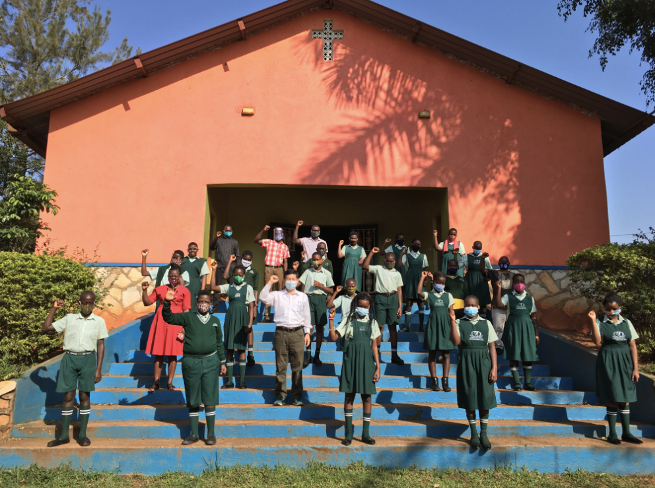
COVID-19 response in Ugandan schools
Interview with Emmanuel Amanya
Valerie Nguyen
Reopening process at Golden Berry School
Due to the smaller size of Golden Berry, school administrators felt it was safe to reopen only for the candidate classes in grade 7.
Separated grade 7 students into two separate classrooms to limit crowding.
Policies the school adopted to prevent COVID-19 spread
Maintain social distance of 2 meters
Hand-washing facility readily available
Provided soap for students
Sanitization points
Disinfecting classrooms and supplies
Hand-washing facilities
Expensive so UPE / government schools found it difficult to purchase and place in their schools - use hand-basins instead.
Private schools like Emmanuel’s were able to pay for the the hand-washing facility and subsequent water bills

Slide 10
COVID-19 Response: Solution Suggestions
Interview with Emmanuel Amanya
Valerie Nguyen
Challenges at UPE / Government schools
Public schools that educate more than 100 students per class.
Lack of social distancing due to such high student population
Lack of funding due to government not well structured and misallocation of funds to schools.
Possible solutions to motivate community involvement in implementing hand-washing facilities at UPE / Government schools in Uganda
Local organizations or communities for outreach into communities to encourage locality to address hand-sanitization access for UPE / government schools
Community pressure for the correct allocation of funds from government to schools; potential to be spearheaded by Head School Administrators
Foundation for Community Development and Empowerment (FCDE)
Partners with local grassroots organizations in a range of fields to meet their mission goals

Slide 11
Understanding Healthcare in Uganda
Nathan Charles
Decentralized
Operates on a referral based system
Multi-tiered infrastructure
Referrals Advance Along Network
Village Health Teams (VHT)
Health Centre (ll, lll, & IV)
Hospitals
Healthcare in Uganda integrates traditional and complementary medicine (i.e. herbal medicine, bone setters, and spiritual healers)

Slide 12
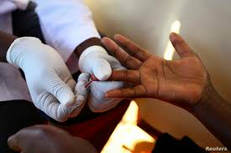
COVID 19 Effects on Ugandan Health Care System
Nathan Charles
Focus on COVID-19 has provided a tremendous strain on essential health services
HIV Testing
COVID-19 in Uganda may undermine and disrupt various elements of care in Uganda
Country-wide regulations put in place to reduce transmission and impact of COVID-19 has negative consequences towards:
Attitudes towards Healthcare
Transportation
Malaria
Disruption in malaria control and intervention methods projected to increase malaria burden on health services
Negative projections:
Malaria Mortality rate could double (with even greater increases in the years that follow)
Notes:
HIV Testing:

Slide 13
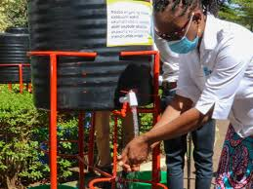
Role and Significance of WASH in Disease Prevention
Nathan Charles
Basic hand hygiene and sanitation efforts are critical practices to the preventing and reducing the transmission of COVID-19
According to a joint report by WHO and UNICEF:
34 million go without having access to basic hand washing facilities with soap and water at home
293 million children across the region of Sub-Saharan Africa do not have access to basic hand washing facilities at school
As of May 2020, the UNHCR has reported a sanitation coverage of 55% in Uganda

Slide 14
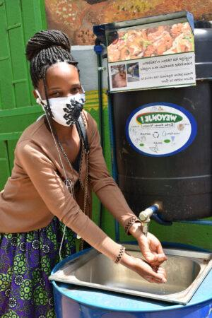
Community Efforts to Improve WASH Access and Conditions
Nathan Charles
Engineers Without Borders (EWB), in collaboration with Response Innovation Lab (RIL), created a community challenge to come up with a low-cost and lockable handwashing station using locally sourced materials

Slide 15
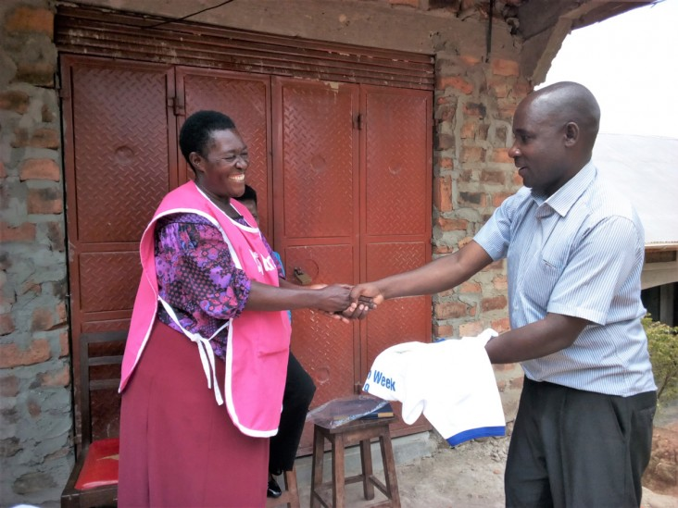
Healthcare Implications Post Covid-19
Nathan Charles
Negative Implications
Malaria cases and mortality will most likely increase, and with more lethality, as COVID-19 continues to strain medical attention
HIV Testing will be down as long as local travel restrictions are in place, with an expected uptick once COVID-19 ends
Potential Positive Implications
Improvement in telehealth technology and communication
Increased WASH practices and behavioral habits
Improved community engagement towards addressing and maintaining sanitation efforts

Slide 16
COVID-19 Response: Global ways to create a COVID relief system
Veronica
ECONOMY
More surveillance
Funding for epidemiology training
Care funds for everyone
Community engagement
Keeping people united while being safe
Extra support in laboratory testing
Accurate data about COVID cases and the status of the virus
Let it be known globally
Tax arrangements
More economic impact payments
Tax relief in global pandemic
COVID AID
CARES ACT
Developed countries should provide economic aid to developing countries struggling with the global pandemic

Slide 17
Focus on emergency management Post COVID-19
Veronica
General suggestions in all countries for COVID relief
Emergency-Care Funds
International Monetary Fund (IMF) has provided extra funds to help countries like Uganda that received SDR 361 million (USD 491.5 million)
Emergency preparedness Plan
A strategic preparedness and response plan is a necessity for healthcare organizations
Track the spread of virus
Improve knowledge on the virus and its impact
Accelerate research on treatments
Readiness to respond to emergency management should be of top priority
Facilitate self quarantine
Disaster Recovery Plan for businesses, especially small businesses to protect employees and the company

Slide 18
Support Epidemiologic Response
Veronica
What is epidemiology? (Epidemiology and Laboratory Capacity)
Prevention of the virus
Controlling emerging viruses
In August 2019, starting a new 5-year period of performance, ELC funded 64 jurisdictions to detect, prevent, and respond to the growing threats posed by infectious diseases through three core areas:
Prevention and intervention
Surveillance, detection, and response
Communications, partnerships
Without any cooperative strategies, there will be no success in getting out from this global pandemic.

Slide 19
Ugandan COVID Response
Veronica
“Given the high degree of vulnerability for the bottom 40 percent of the population, particularly in rural areas and refugee-host communities, the COVID-19 pandemic is bound to disrupt essential health and social services and exacerbate gender-based violence (GBV). The GoU needs to take a number of measures to minimize the multi-faceted impacts of this rapidly evolving situation”
Uganda has reopened the economy by allowing more access to the foreign exchange market to get back on track.
Increase testing capacity
The Uganda Research Unit
More funds to accelerate the research in preventing the spread of the virus
Social Protection and Community Engagement
Developed school programs for mitigation and prevention of COVID in schools

Slide 20
Thank you
Questions, feedback, and general comments are welcome.

