Slide 1
Understanding and strengthening women's presence — “iKnow” Concert Series
Public Health and Music
Manjari Devkota, Andrew Nangoli, Mark Mutesasira, Alexandra McDermott

Slide 2
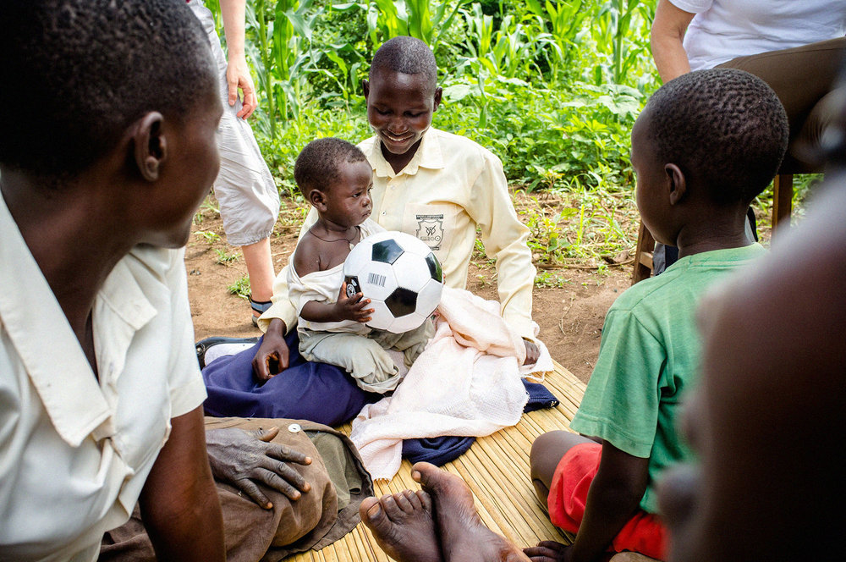
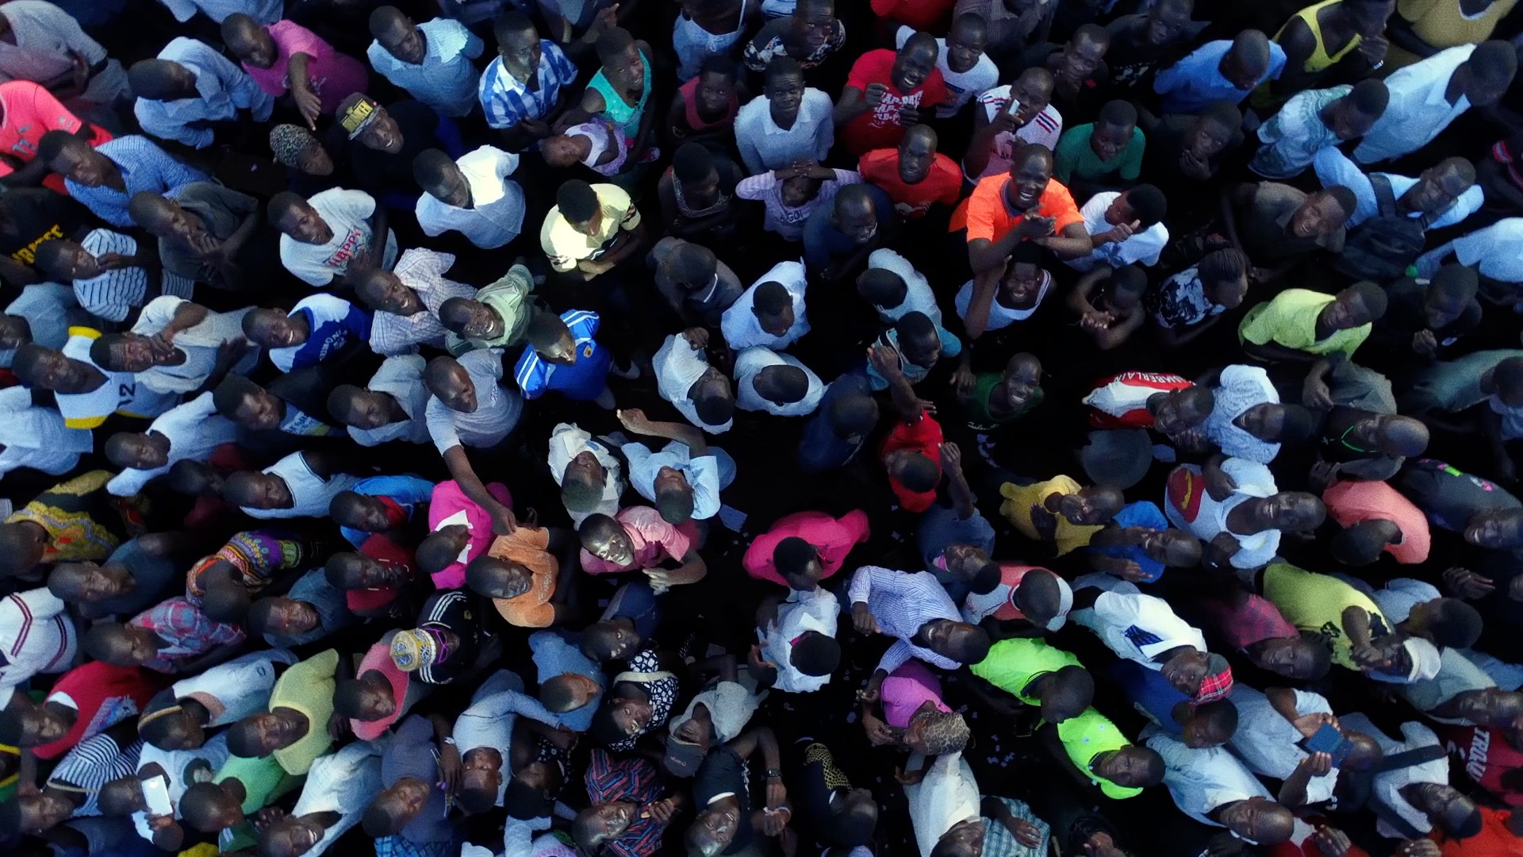
Introduction
2014: 4,000 people; by 2019: 300,000 people
HIV testing, products for reproductive health, cancer screening
Power of music
GLIs reflection: strengthen women participation and increase numbers
Goal: understand the existing barriers and provide recommendations

Slide 3
Literature Review
Social Context
Hussein and Ferguson (2019): stigmatization is closely linked to the social and cultural context
Parker and Aggleton (2003): “discrimination is supported by the concept of power, privilege, and dominance.” — social milieu and gendered hierarchy of Ugandan culture
Education
Adams et. al (2019): GLI —Completion of high school associated with reduced negative attitudes towards HIV/AIDS
Supported by UNFPA (2013): Educated women open to talking about HIV/AIDS.
Tsai and Venkataramani (2015): DHS (implementation of the 1997 Primary Education Policy) — additional years of education does not have a causal effect: importance of both academic and social education

Slide 4
Cont.
Cultural/ Religious Leaders
Promote inclusivity and address misconceptions
Zou et. al (2009): some associate it with immoral behavior: punishment from God
Women Organizations:
USAID (2013): Empowerment: building confidence, helping navigate sickness, providing a safe space
Paudel and Baral (2015): Decreased feelings of isolation and shame, increase social networks, improve self-care behaviors
Recommendation to be offered as a fundamental HIV/AIDS service

Slide 5
Cont.
Health care
Kleinman et. al (2011): TASO (1980s) began free counseling, social support, mobilization
Nyblade et.al (2003): health care providers also belong in the same social and cultural milieu
Compromises the quality of service, diagnosis, and treatment
Discourages them to seek help

Slide 6
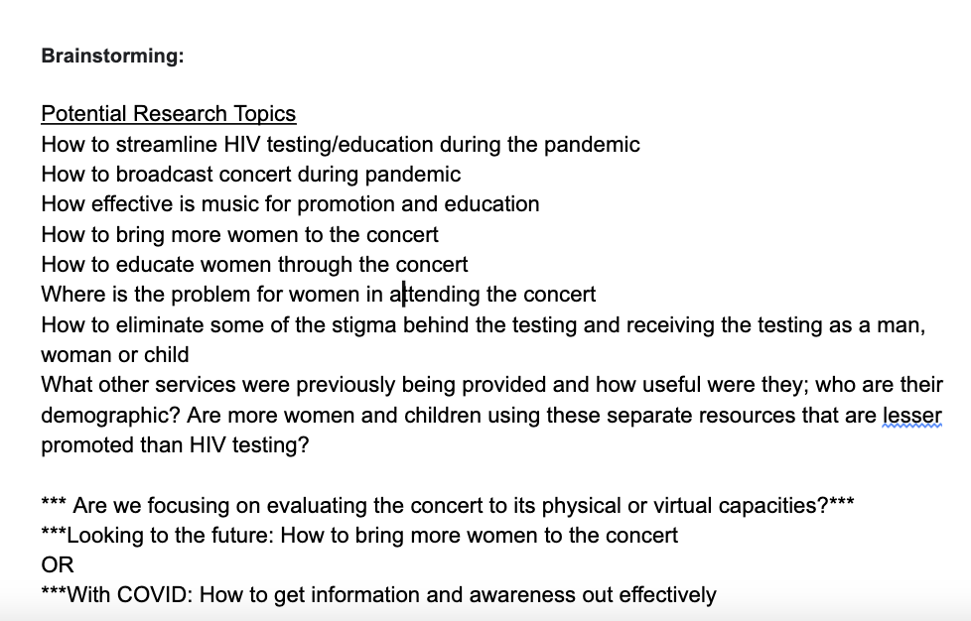
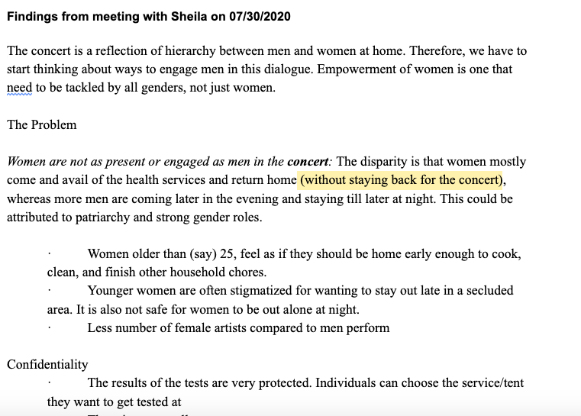
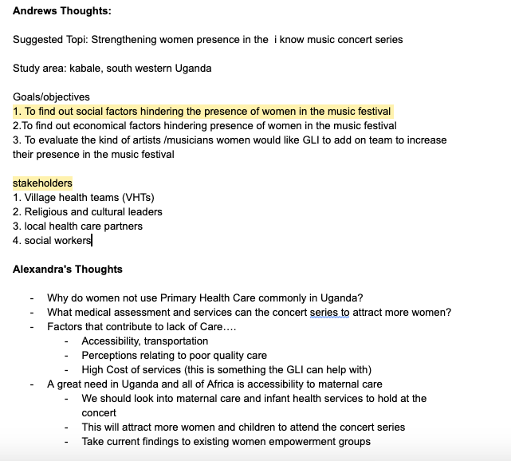
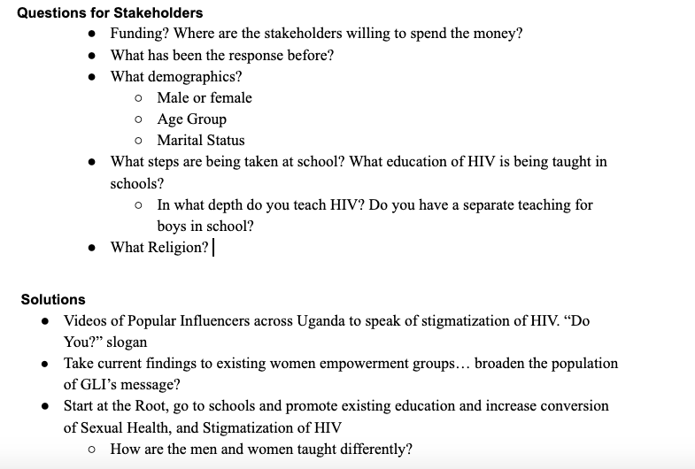
Project Development

Slide 7
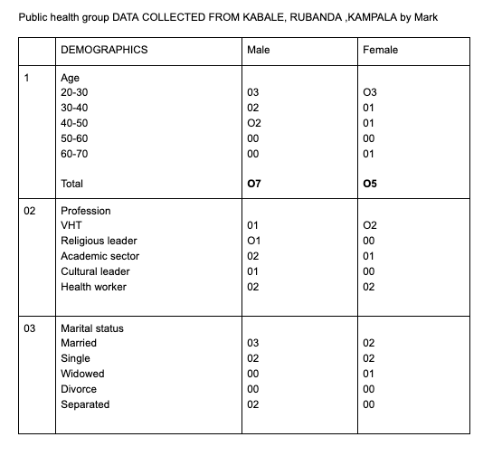
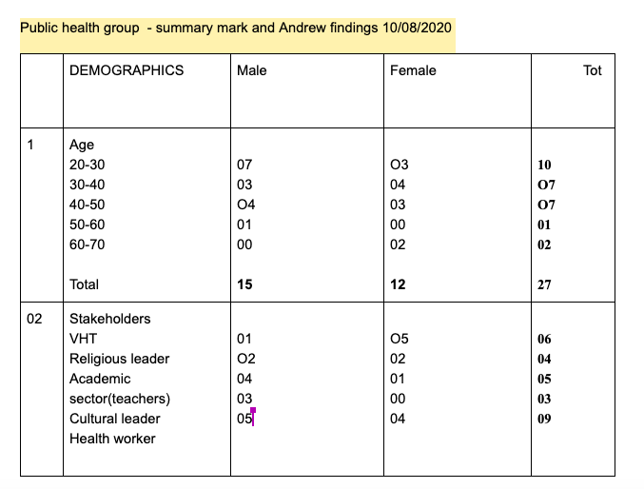
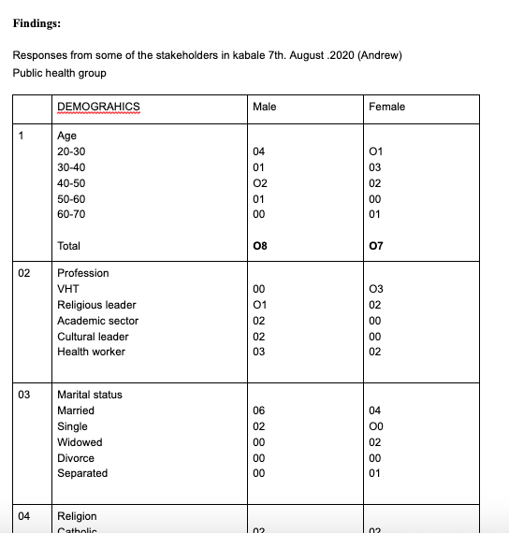
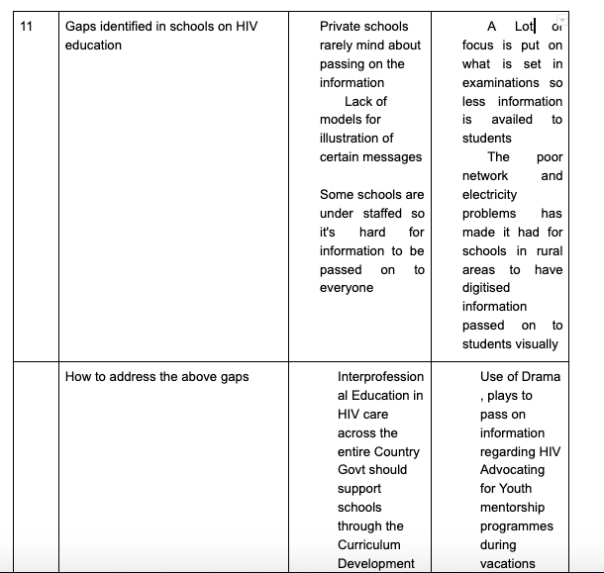
Cont.

Slide 8
Research Questions
What are the cultural and societal factors that prevent a stronger women's presence at the concert?
How does the empowerment of the genders increase the effectiveness of destigmatizing HIV/AIDS?

Slide 9
Findings: Stakeholders
South West Uganda and Kampala
Reached through direct interview and phone calls
27 different stakeholders : 15 men, 12 women
6 VHTs, 4 religious leaders , 6 teachers , 3 cultural leaders, 9 health workers

Slide 10
Demographics
Variable |  | Frequency
Marital Status | Single | 15
 | Married | 6
 | Widowed | 3
 | Separated | 3
Age Category | 20-30 years | 10
 | 30-40 years | 7
 | 40-50 years | 7
 | 50-60 years | 1
 | 60-70 years | 2
Religion | Catholic | 8
 | Anglican (COU) | 12
 | Pentecostal | 2
 | Islam | 3
 | Traditional | 2

Slide 11
Findings cont.
All members agreed that GLI had engaged women before
How to reach more women?
Directly engage and work with existing women empowerment groups
Take integrated services closer to hard to reach communities by facilitating stakeholders
Come up with strategic mobilization measures: use of role plays on HIV awareness and destigmatization by locally organized groups
Skits: societal challenges that the Ugandan women face: engaging locals
Entertainment as well as representation of the unspoken realities
Involve more women VHTs to reach out to more women
Empower religious and cultural leaders through basic trainings on HIV prevention and testing
Involve more women artists in the concert
Advocate for more free women friendly services like sanitary pads , UTI and STI screening services
Reconsider timing of the concert 67% yes and 33% No

Slide 12
Findings for Education (Mark)
How is HIV education performed at school?
59.3% stated HIV education is mandatory
37% stated it is optional
3.7% did not know how it was done
Are boys and girls educated jointly?
88.9%: Yes
10.1%: No

Slide 13
cont.
What are the gaps you have identified?
Inadequate reading materials: misinformation on HIV prevention knowledge from teachers to students
Less time given to HIV awareness compared to other academics amongst teachers
Suggestions to address the gaps?
Government, private sectors and NGOs to integrate more prevention information in school programme and curriculum
Provision of HIV reading materials in school
Package HIV prevention information in the form of videos and/or drama (visual impact is effective)
Advocate and plan for termly training in the form of seminars for teachers and peers to strengthen HIV knowledge

Slide 14
Empowerment and its link to stigmatization of HIV
Social factors that decrease women empowerment and increase stigmatization of HIV in East Africa
Differentiation of gender equality
Gender equality
Societal roles/ standards
Little to no male intervention/ involvement

Slide 15
Women Empowerment Background - Research
Frontiers of Psychology Research
Women’s status and empowerment affect their health, nutrition, socioeconomic status of both women and children across the African continent and the globe.
Conducted Research over 34 countries across Africa
Empowerment Indicators
Economic, Socio Cultural, Education and Health
“This validated measure is a useful tool for global health researchers in assessing the impact of women's empowerment on health outcomes.” (Asaolu et al. 2018)

Slide 16
Women Empowerment Research Cont.
The Journal of International Aids Study
They have connected that gender inequalities and livelihood insecurities is a great promoter and driver of resulting in women and children being very vulnerable to HIV
Methods: “...key academic databases to identify interventions that simultaneously sought to strengthen people's livelihoods and transform gender relationships that had been evaluated in southern and eastern Africa.” (Journal of International Aids Society).
Resulted: Intervention of Primary and Secondary Education of Women and Children
Concluded: Gender Inequality is linked to HIV vulnerability of women and children, little to no male involvement in interventions.

Slide 17
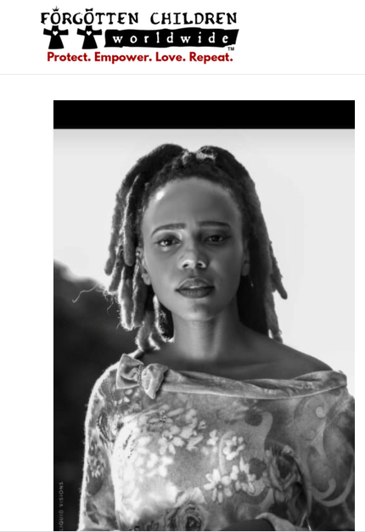
Women Empowerment Organizations
Forgotten Children Worldwide “Protect. Empower. Love.Repeat”
Protects those that are vulnerable
Forgotten Children Worldwide has a great Women Empowerment Program that provides women and girls the education and the steps for success. It equips the girls with an education of their rights and gives the skills to be successful in their adulthood.

Slide 18
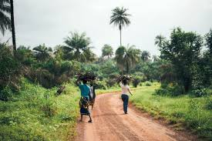
Women Empowerment Organizations Cont.
Ripples Farm Foundation “Empowering Young Women”
Ripples, provides a foundation for women and their families. It gives them an upbringing to be an example in their community and for other women.
Trains Women to start eco- friendly farming businesses.
Statement from Ripples Farm
“We partner with local and volunteer healthcare practitioners to co-develop solutions that address local health concerns, providing basic medical services and equipment to even the most remote village”

Slide 19
Women Empowerment Organizations Cont.
Africare - Women’s Empowerment
Provides a great platform and opportunity to seek economic benefits and skills. It provides great opportunities for women to stand out in their community and become leaders.
Developing Leadership Skills and applying toward their community

Slide 20
Common Theme...
Women’s Empowerment Research
Women’s Empowerment Organizations

Slide 21
Recommendations to GLI Board
Possible Partnerships With Women’s Empowerment Groups Across Africa
Forming Partnerships and Increasing Awareness of GLI’s message to Women Empowerment
Increase of Awareness we can see an Decrease in Stigmatization of HIV
Promoting Positive Cultural Change
Timing of Concert? Male Involvement/ Intervention

Slide 22
Recommendations cont.
Video clips
GLI to reach out to popular figures for the dissemination of messages — video to be screened during concert breaks
“Let’s talk about it!”
“My wife and I have conversations about HIV/AIDS and we practice safe sex”
“I am attending the concert with my wife, how about you?”
“Concerts are more fun if you are together with your loved one”

Slide 23
Challenges
Limited time
Some stakeholders were not willing to be interviewed
Unable to reach out to stakeholders in far rural communities (network/far distance)
Incurred costs in form of transport and Airtime

Slide 25
References
Adams, Jessica, et al. “Music as a Vehicle for Reducing HIV Stigma and Increasing Access to Testing in Rural Uganda: A Quasi-Experimental, Mixed-Methods Study.” Sociology International Journal, vol. 3, no. 6, 2019, doi:10.15406/sij.2019.03.00208.
Asaolu IO, Alaofè H, Gunn JKL, Adu AK, Monroy AJ, Ehiri JE, Hayden MH and Ernst KC (2018) Measuring Women's Empowerment in Sub-Saharan Africa: Exploratory and Confirmatory Factor Analyses of the Demographic and Health Surveys. Front. Psychol.
Gibbs, Andrew, et al. “Combined Structural Interventions for Gender Equality and Livelihood Security: a Critical Review of the Evidence from Southern and Eastern Africa and the Implications for Young People.” Journal of the International AIDS Society, vol. 15, no. 3
Green EC, Halperin DT, Nantulya V, Hogle JA. Uganda's HIV prevention success: the role of sexual behavior change and the national response. AIDS Behav. 2006;10(4):335-350. doi:10.1007/s10461-006-9073-y
Hussein, Julia, and Laura Ferguson. “Eliminating Stigma and Discrimination in Sexual and Reproductive Health Care: a Public Health Imperative.” Sexual and Reproductive Health Matters, vol. 27, no. 3, 2019, pp. 1–5., doi:10.1080/26410397.2019.1697103.
Kleinman S, Talbot JR, Harris J, Ellner A. The AIDS Support Organization (TASO) of Uganda. Harvard Business Publishing. 2011.
Remaining can be found in the final paper.

