Slide 1
GLI x GRC Cost Effectiveness
May 2, 2023
Prepared for the Global Livingston Institute

Slide 2
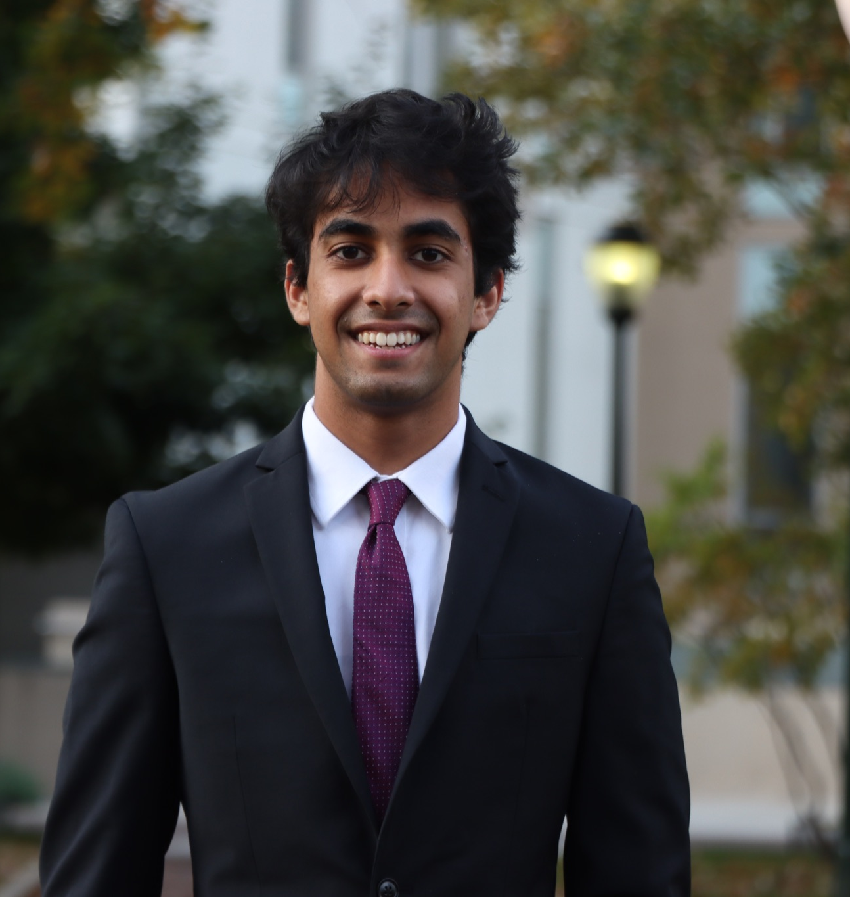
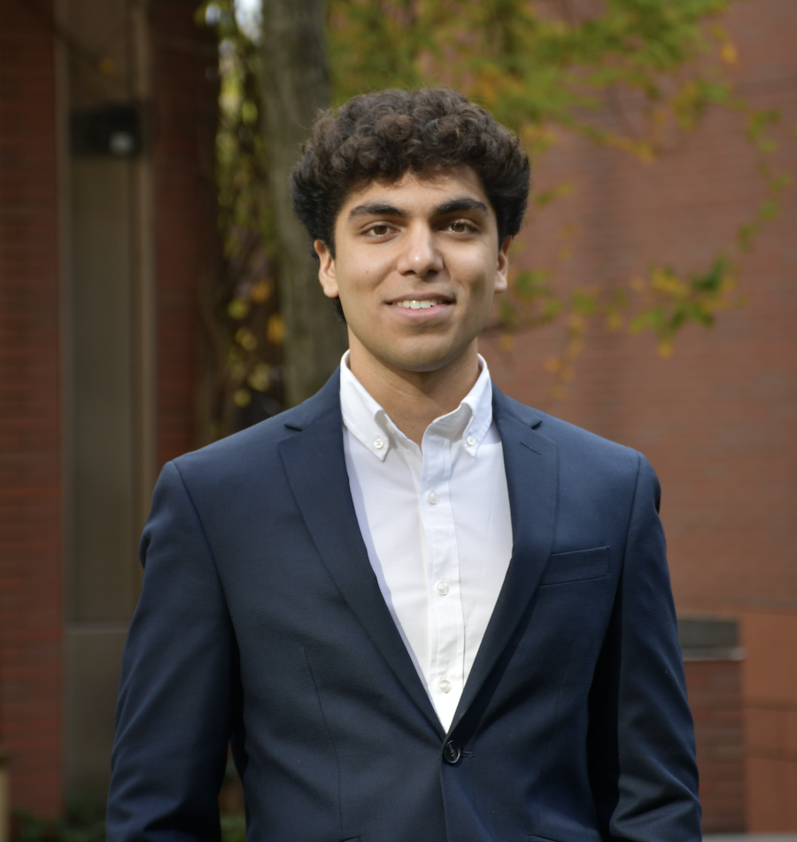
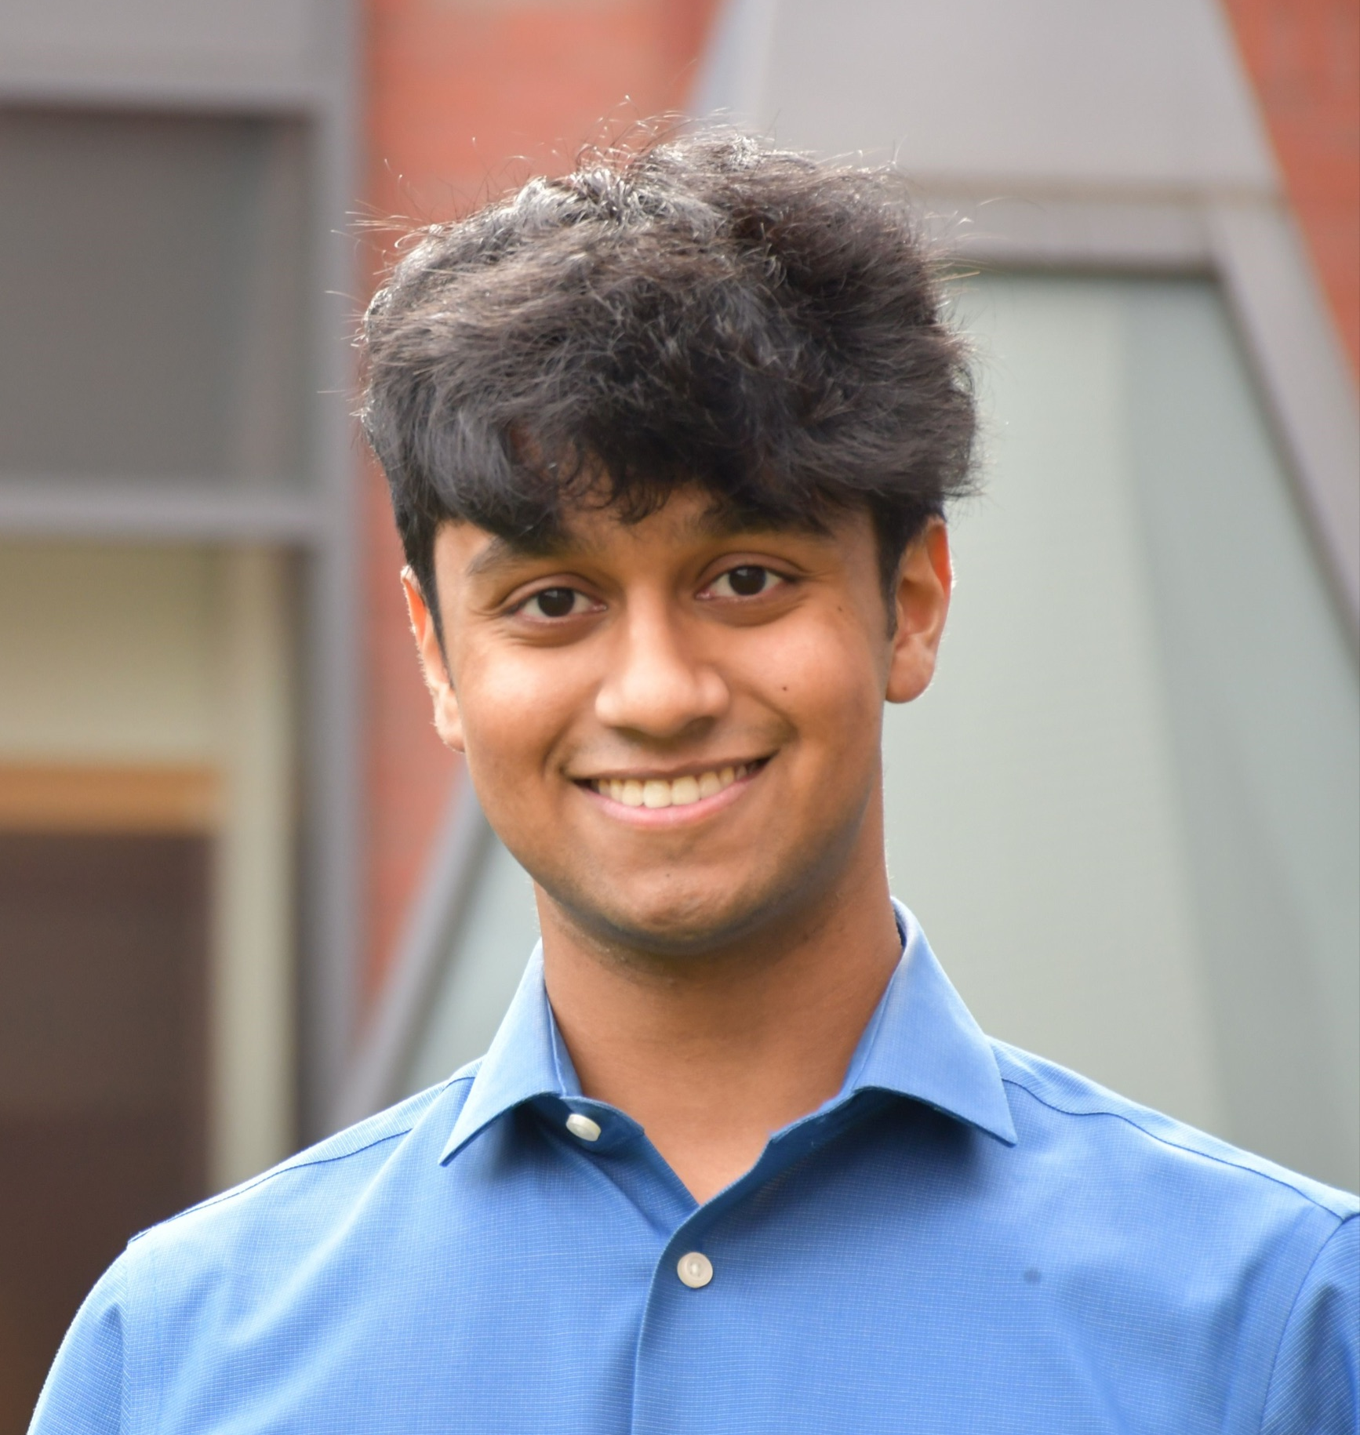
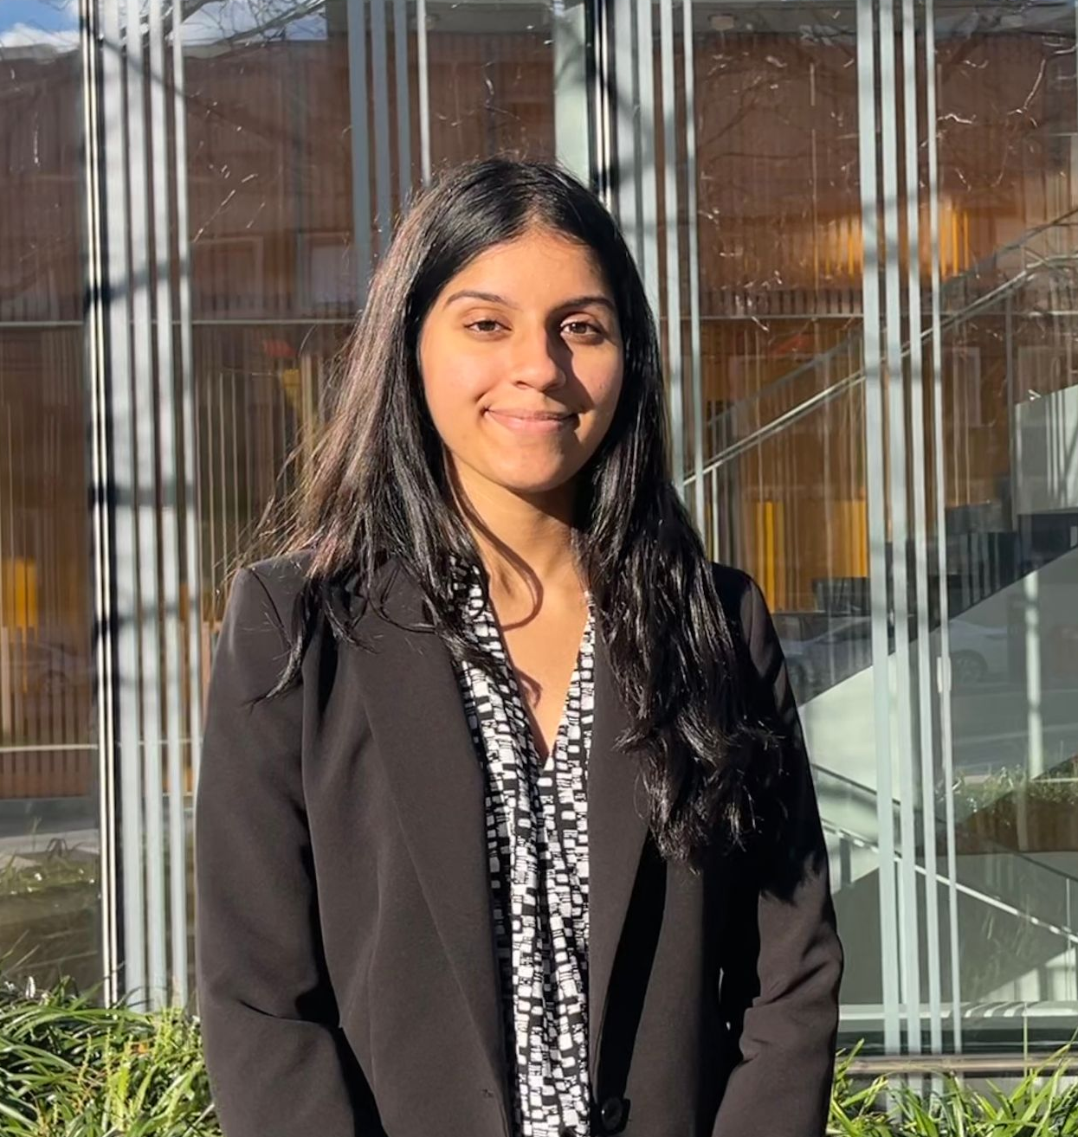
Our Team
Nikhil
Srivastava
Project Lead
Ron
Batra
Consultant
Ashleigh
Huang
Consultant
Stephen
Thomas
Consultant
Prableen
Kaur
Consultant
Shruti
Ramkumar
Consultant
Notes:
Everyone

Slide 3
GLI NCD Overview and Relevance
Notes:
Ron

Slide 4
Background
The GLI non-communicable disease prevention program in Uganda addresses hypertension and diabetes in rural areas. This is an important challenge to address as:
Recent decline in poverty and a rise in economic prosperity over the last two decades has led to changes in societal cultures and occupations, resulting in a more sedentary lifestyle.
Many Ugandans are further at risk of NCDs due to alcohol consumption, high blood pressure, tobacco use, and obesity.
Historically there has been minimal government assistance and expenditure on health care.
These contribute to high levels of NCDs in various regions throughout the country, with exposure ranging between 20%-50% depending on the population subset (Harvard Public Health Review).
Notes:
Ron

Slide 5
GLI Cost Overview
Notes:
Prableen

Slide 6
We identified six major projects held by GLI since July 2022.
CHWS Training
Provider Costs
Monthly Follow-Ups
Community Garden
Nutritional Classes
Exercise Classes
Training programs that included residential and transportations costs for community health workers.
Payments delivered to hospitals labeled as administrative fees.
Payments delivered to community health workers to provide monthly check-ups. Includes stipends and transportation cost.
A nutritional garden was developed that can provide healthy options and required purchases for maintenance, supplies, and labor.
Classes designed to increase nutritional awareness in the community that can prevent the risk of developing NCDs.
Classes designed to increase activity and mobility by creating opportunities for exercises in group settings.
Notes:
Prableen

Slide 7
We represented the cumulative data by overall expenditures and by project.
Notes:
Ashleigh

Slide 8
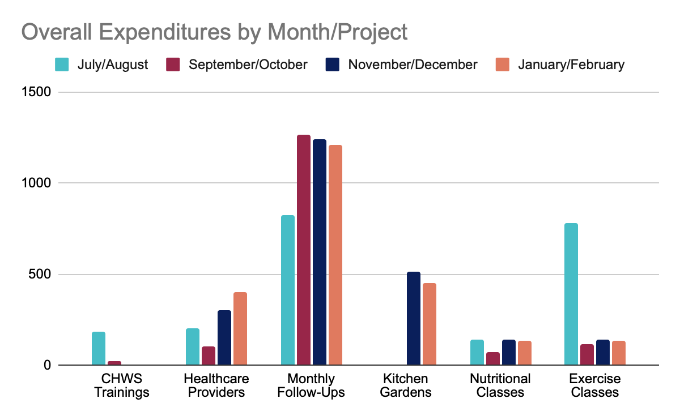
Excluding initial fixed costs, monthly expenditures by project remained consistent.
Notes:
Ashleigh

Slide 9
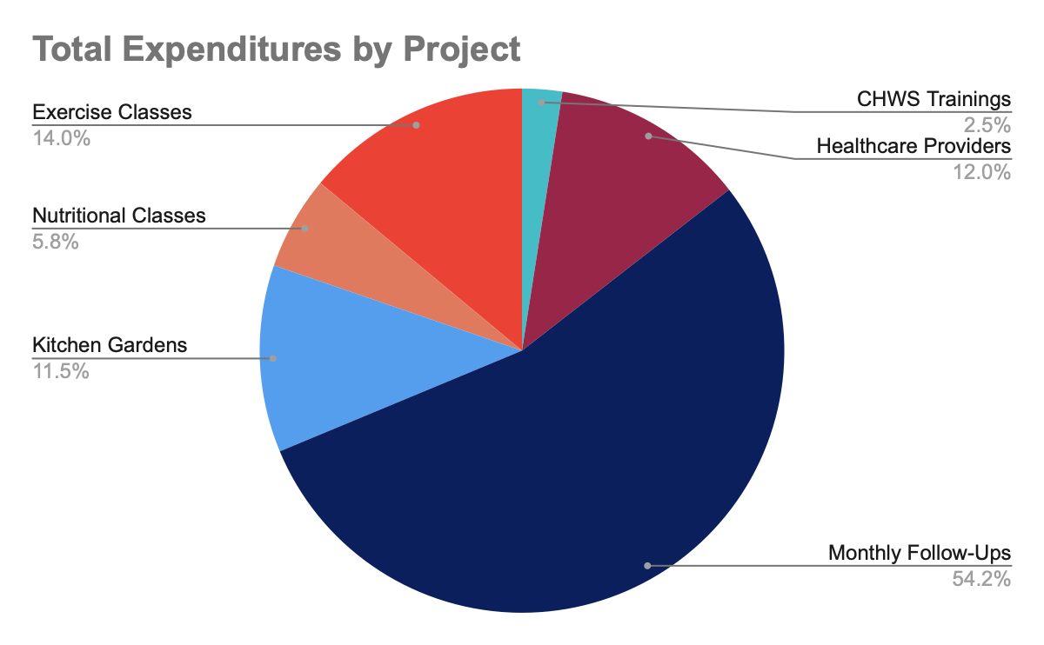
Monthly follow ups represent the highest proportion of total expenditures.
Stipends to CHWS made up over 50% of the overall expenses.
Classes that can be widely attended require minimal overall expenditures.
Using an exchange rate of 3600 UGX = 1 USD, cumulative expenditures on all projects was $8373 USD.
Total Expenditure | 30,143,550
Monthly Follow-Ups | 16,351,250
Kitchen Gardens | 3,481,400
Exercise Classes | 4,206,000
Nutritional Classes | 1,740,900
Notes:
Stephen

Slide 10
Cost Effectiveness Analysis
Notes:
Nikhil

Slide 11
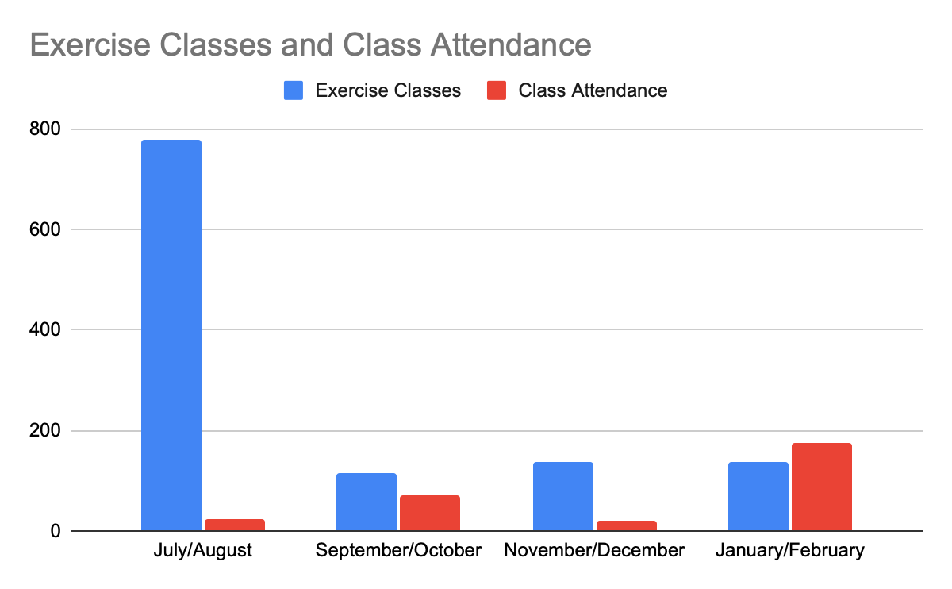
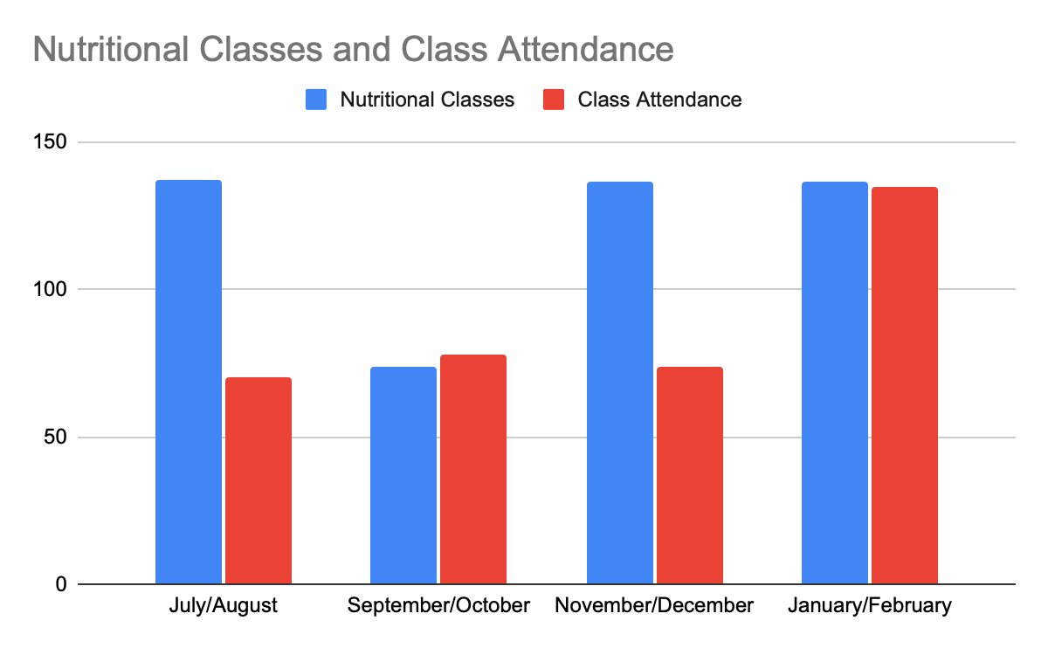
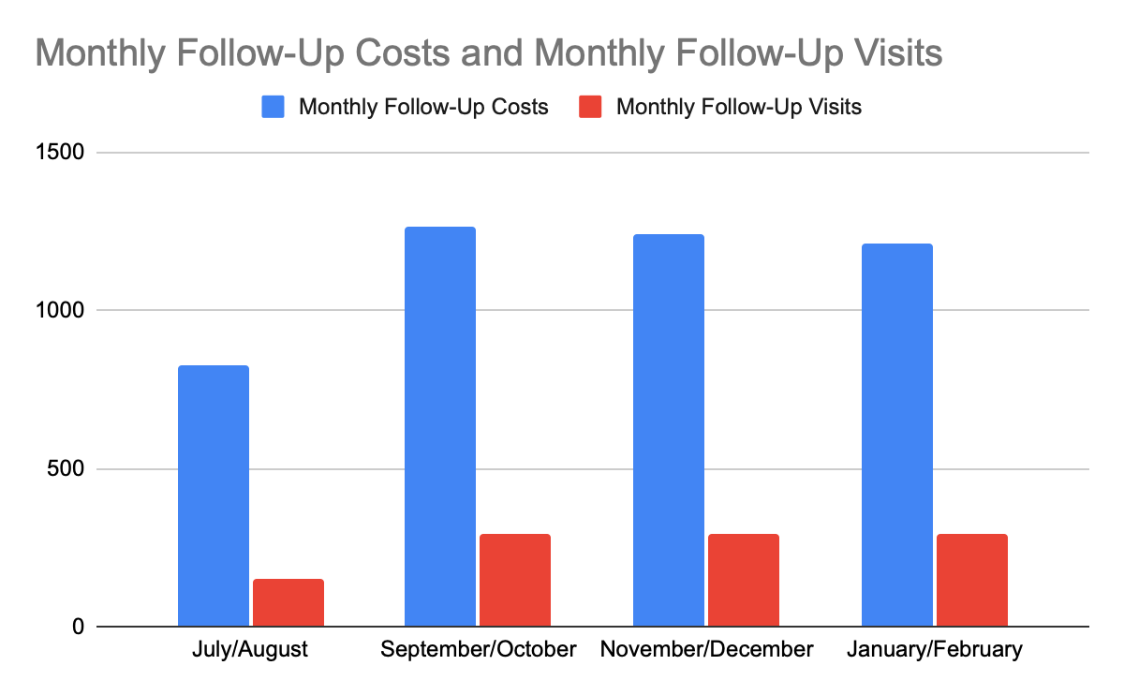
Analyzing monthly costs and program outcomes indicate sustainable GLI programs.
Increased spendings are generally associated with increased outcomes.
Starting costs distort program success and programs increase effectiveness over time.
Consistency of spending and outcomes over many months signal efficient and sustainable results.
Notes:
Shruti

Slide 12
After categorizing expenses and outcomes, we found the unit cost of each program.
 | Total Costs | Excluded Starting Costs | Variable Costs | Services | Individual Costs | Unit Variable Costs
Monthly Follow-Ups | $4524.1 Includes stipend and transportation | None | $4524.1 Includes stipend and transportation | 1028 Check-Ups | $4.4 Unit cost of check-up | $4.4 Unit cost of check-up
Kitchen Garden | $967.06 Includes setup and maintenance | Fencing, Mulching & Grass | $240 Includes cost of gardener and seeds | 86 Bundles | $11.24 Unit cost of garden bundle | $4.4 Unit cost of garden bundle
Nutritional Classes | $483.58 Includes cost of nutritionist and water | Water | $476.36 Includes only cost of nutritionist | 357 Attendees | $1.35 Unit cost of attending class | $1.33 Unit cost of attending class
Exercise Classes | $1168.34 Includes equipment and trainer salary | Yoga mats & exercise water | $525 Includes only cost of trainer salary | 290 Attendees | $4.03 Unit cost of attending class | $1.81 Unit cost of attending class
Notes:
Nikhil

Slide 13
Our individual monthly cost estimates reveal a per person cost of $25.4 per person.
$25.4 USD/ Per Person
=
2 Bimonthly check-ins
$8.8 USD
1
Garden Bundle
$11.24 USD
1 Nutritional Class
$1.35 USD
1 Exercise Class
$4.03 USD
Notes:
Nikhil

Slide 14
Scaling for Growth
Notes:
Nikhil

Slide 15
Community Gardens Program
Programs
Program aimed at increasing physical activity and improving access to nutritional diet to improve health outcomes.
Program Components
Objectives
Scaling (Dissemination and Advocacy)
Growing large amounts of nutritional food in a low cost environment to improve accessibility in the community.
To improve diets by increasing access to nutritional food resources.
To promote healthy habits and guide others.
To reduce the incidence of NCDs, such as obesity, diabetes, and cardiovascular disease
Hiring garden managers to act as effective relays between the central organization and satellite gardens.
Creating a garden action plan before each community garden is begun to scope and determine project goals.
Working with both elderly and youth communities to promote garden development and improve mental wellbeing.
Creating campaigns to rotate workers and increase the rate of physical activity conducted by all workers.
Notes:
Stephen

Slide 16
Nutritional Awareness Program
Programs
Program aimed at increasing awareness about the health risks associated with unhealthy diets and promoting healthy eating habits.
Program Components
Objectives
Scaling (Dissemination and Advocacy)
Arrange workshops, led by nutritionists and dietitians, to teach the community about healthy eating habits and practical ways to include healthy foods in their diets.
Increase physical activity levels to improve overall health.
Promote lifestyle habits that will build over time.
Encourage regular participation to maintain healthy habits and reduce the risk of NCDs
Partnering with community organizations/healthcare providers can expand the program's reach
Advocacy efforts could focus on policy changes, such as food labeling laws and regulations on unhealthy food marketing to children.
Host community events like health fairs and cooking demos to encourage healthy eating habits. Attendees will get to interact with health professionals.
Conduct education campaigns to raise awareness about the health risks of unhealthy diets and promote healthy eating habits through social media, TV, and radio.
Notes:
Shruti

Slide 17
Exercise Program
Programs
Program aimed at improving the health of individuals through consistent exercise classes and resources.
Program Components
Objectives
Scaling (Dissemination and Advocacy)
Introduce diverse exercises that target various areas of the body, such as cardio, strength training, and flexibility, to improve participants' overall fitness levels.
To increase awareness about the health risks associated with unhealthy diets
To promote healthy eating habits among the population
To reduce the incidence of NCDs, such as obesity, diabetes, and cardiovascular disease.
Train additional instructors who can teach the exercise class to expand the program's reach and provide more class sessions.
Regularly evaluate participant satisfaction to identify areas for improvement and ensure the program is meeting its goals.
Provide one-on-one coaching or group accountability sessions to help participants stay motivated and maintain healthy habits outside of the exercise class.
Hold educational workshops that emphasize healthy habits, including nutrition, stress management, sleep & hygiene, through workshops, presentations, or handouts.
Notes:
Anyone!

Slide 18
GLI x GRC Final Presentation
May 2, 2023
Prepared for the Global Livingston Institute

